Slide 1

CHARGER DESIGN FOR LIGHT ELECTRIC VEHICLES
Shuvam Keshari (16EE10046)
(under Prof. Dipankar Debnath)

Slide 2
Objective
The aim of this project is to design an efficient charger for light (3kW) electric vehicles (e-rickshaws with > 45kmph).
Final target battery: 200Ah 72V 40A Li-ion (LiFePO₄) with 140 km range (cc/cv charging modes)

Slide 3
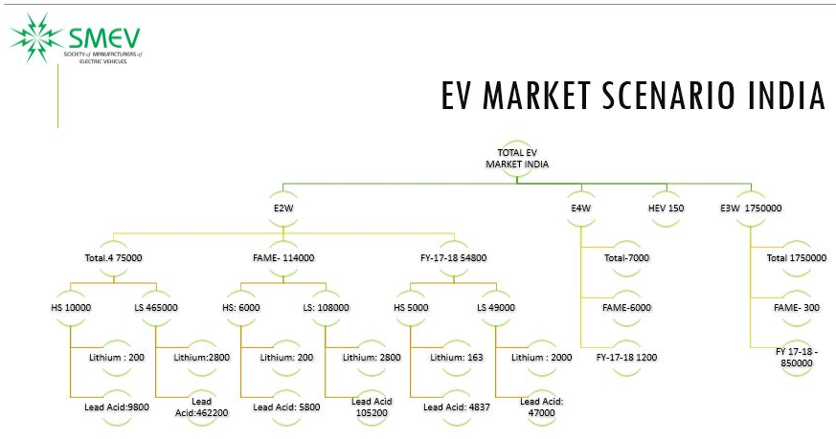
Motivation

Slide 4
Motivation
Hero Eco, Ather, Electrotherm, Avon, Lohia, Ampere (SMEV)
>90% of EVs on Indian roads are low-speed electric scooters (<25km/hr)
with FAME-2 the Industry may witness a quantum leap in volumes and technology
Carbon footprint
Crude oil imports
Creating jobs
https://www.smev.in/ev-industry

Slide 5
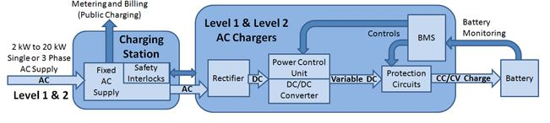
Schematic of a typical EVSE

Slide 6
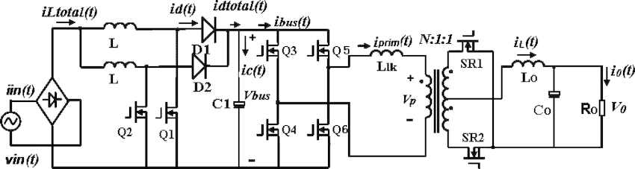
Target architecture
Interleaved PFC
PSFB

Slide 7
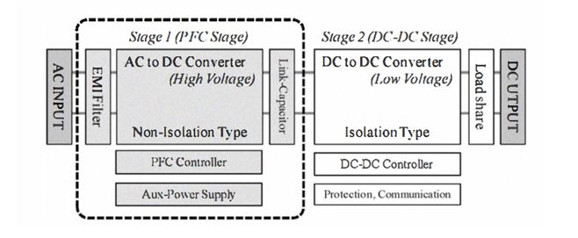
Design Sequence
Auxillary Power Supply Design
PFC Design and Testing with resistive load
PSFB Design and Testing with PFC
Integration of CC/CV modes

Slide 8
Design of the Auxiliary Power Supply
The only source of energy in an EV is the battery (72V)
3 different grounds needed for various components
Battery ground (with 16V output)
AC ground (with 16V output)
microcontroller ground (with 8V output)
DCM Flyback
[why DCM? {3.3}]
CCM Buck

Slide 9
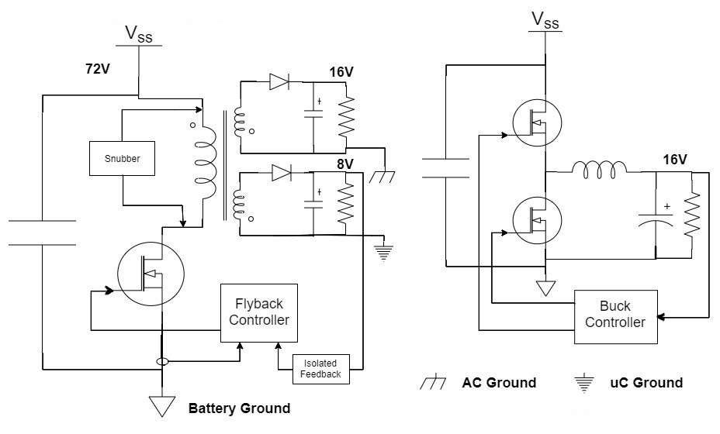

Slide 10
Design of the DCM Flyback Converter (24W)
Input Voltage Vdc : 40V - 60V (since 48V battery was available for prototyping)
1st Output Voltage V1 : 16V (0.1 - 0.5A) with V < 5%
2nd Output Voltage V2 : 8V (0.2 - 2A) with V < 5%
3rd Output Auxilliary Voltage Vaux : 16V (50mA) with V < 5%
Output Power Po : 24W (max)
Switching frequency fs : 100kHz
Minimum efficiency : 75%
Controller IC used : NCP (ON Semiconductor)

Slide 11
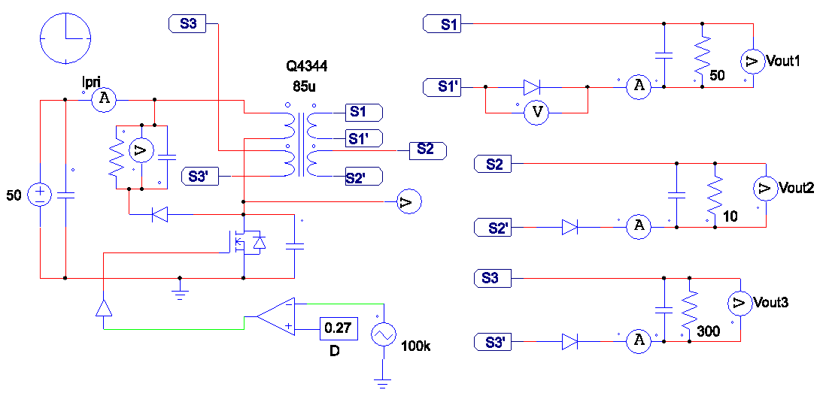
Simulation

Slide 12
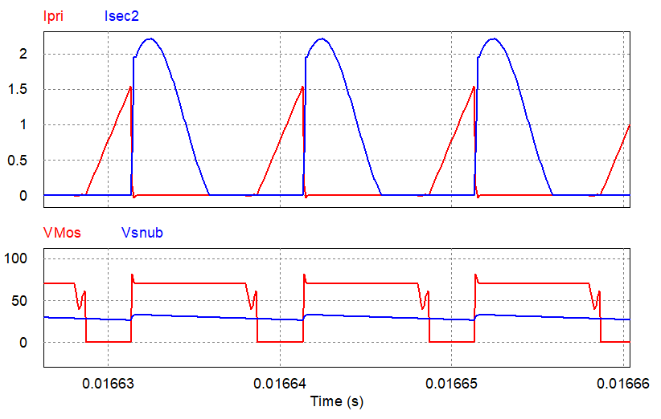
Results

Slide 13
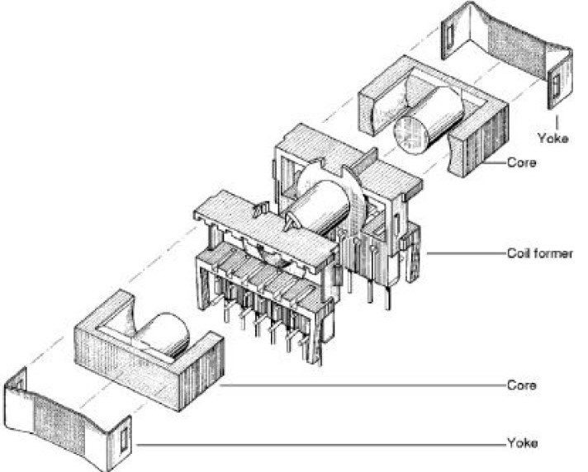
Selection of Hardware components
All preliminary calculations were carried out for capacitors, inductors and mosfet ratings [section 3.4.2 of the thesis]
Transformer core selection was also done along with wire selection, air gap and no. of turns [3.4.3]
Snubber design was also carried out
Control using NCP1203 IC was done referring to its datasheet

Slide 14
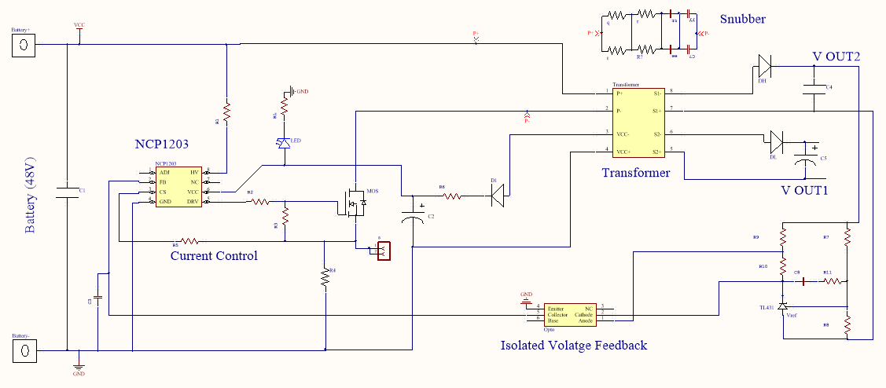
Final schematics (Altium Designer)

Slide 15
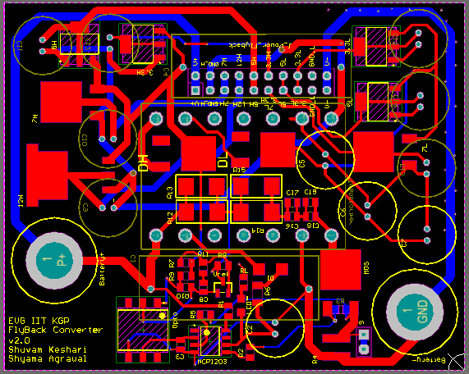
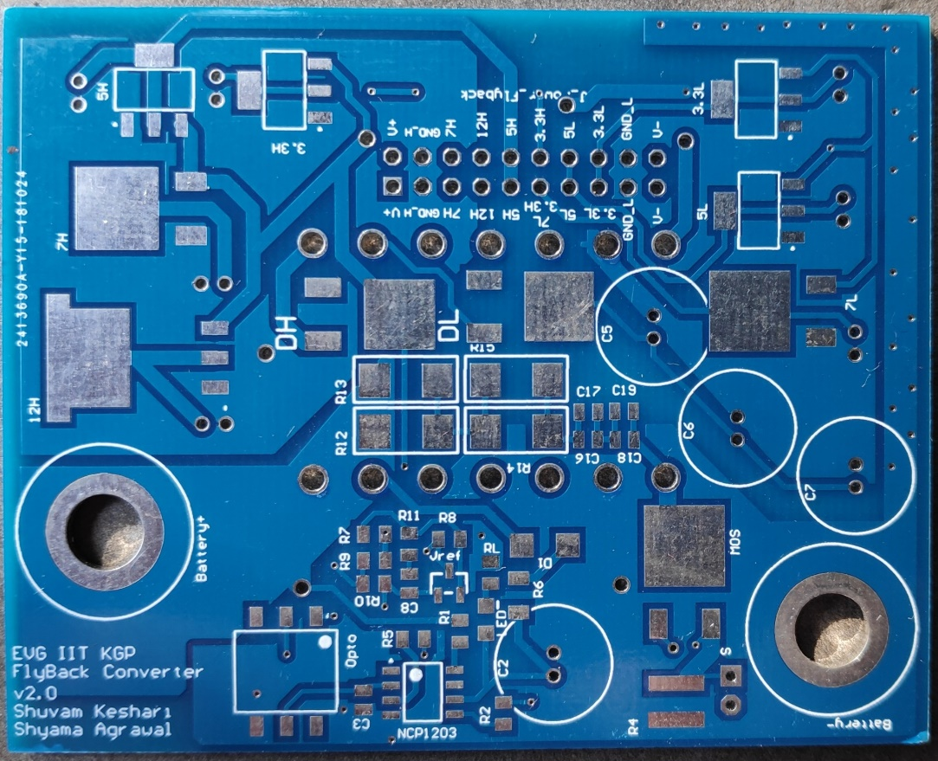
Fabrication
Fabricated PCB
2 layered PCB layout

Slide 16
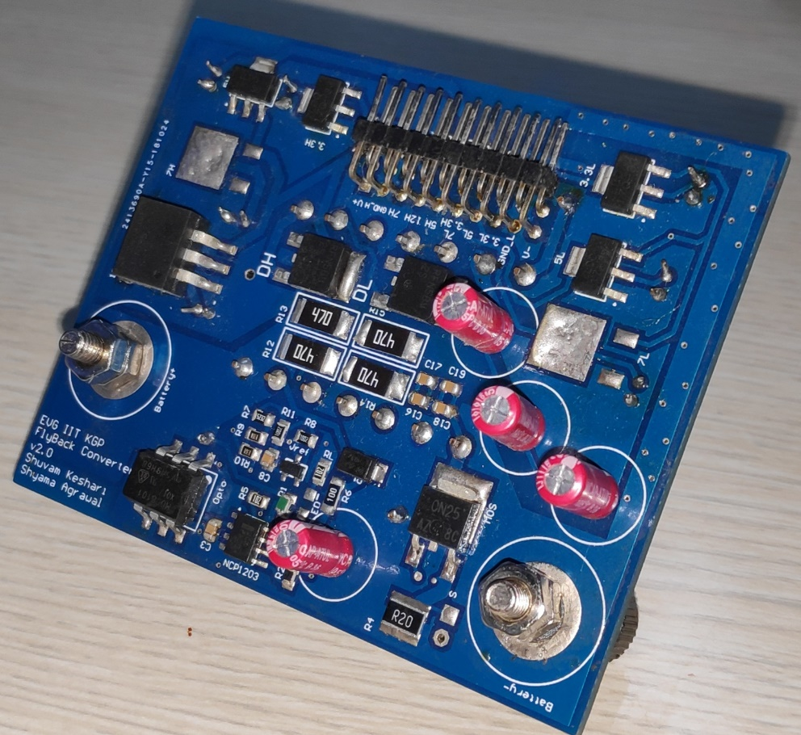
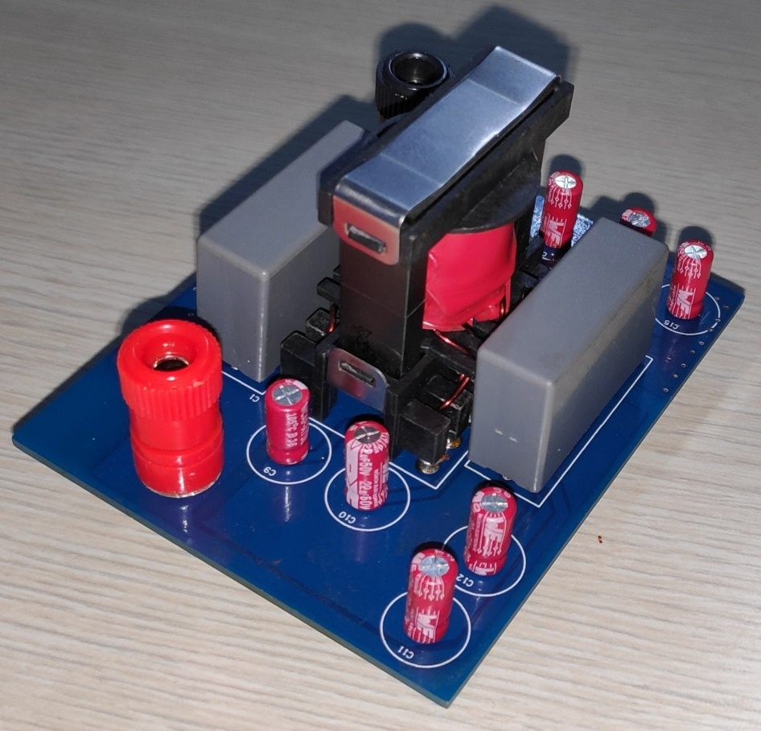
Soldered components

Slide 17
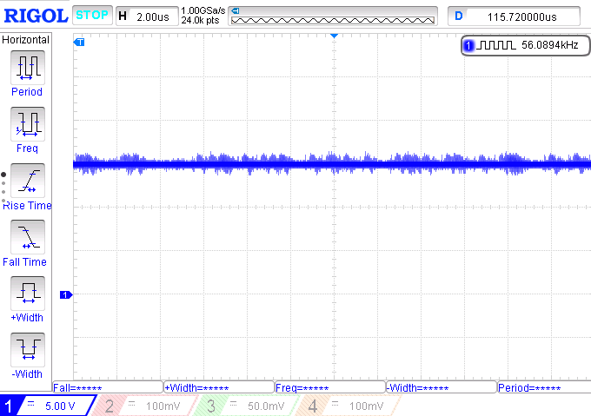
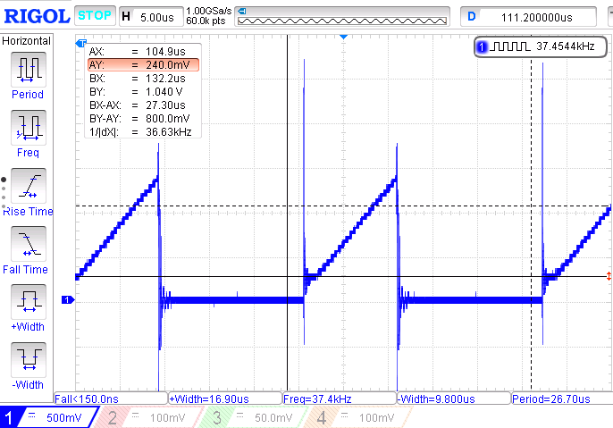
Hardware results
Output Voltage 16V
Primary current (DCM)

Slide 18
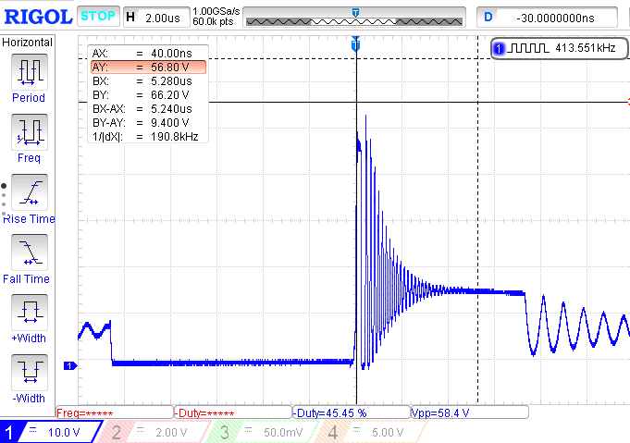
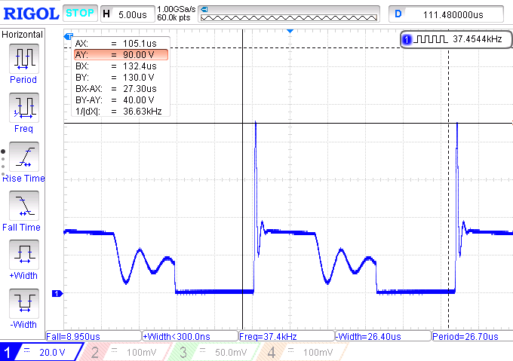
Snubber improvement
Voltage across drain-source of mosfet due to various snubbers

Slide 19
Design of the Buck Converter (80W)
Input Voltage Vdc : 40V - 60V (since 48V battery was available for prototyping)
Output Voltage V0 : 16V (5A) with V < 5%
Output Power Po : 80W (max)
Current ripple IL : 0.5A
Switching frequency fs : 50kHz
Minimum efficiency : 75%
Controller IC used : TL494 with a gate driver (IRS2184)
Similar calculations were performed like the flyback

Slide 20
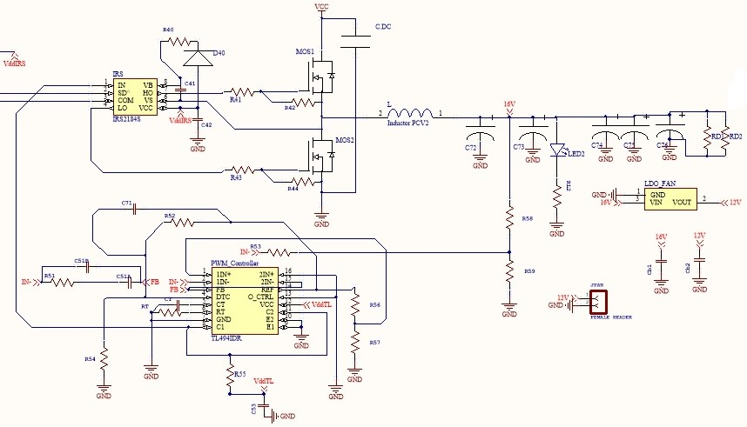
Schematic (Altium)

Slide 21
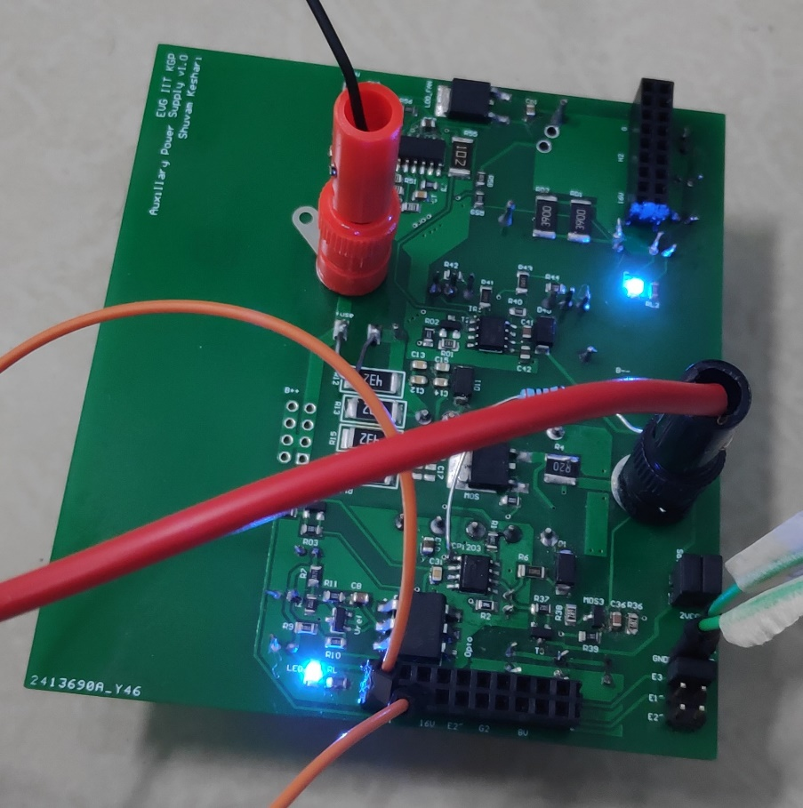
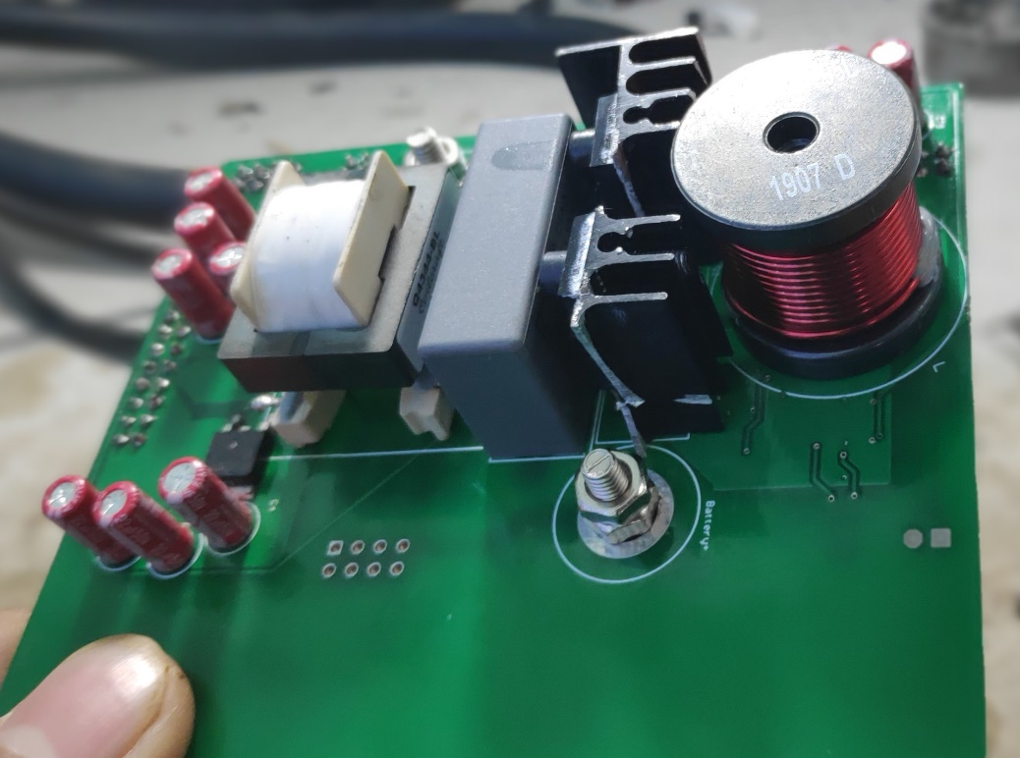
Combined with Flyback and fabricated on the same PCB
Flyback portion
buck portion
Working PCB
Common film capacitor

Slide 22
Power Factor Correction Stage
Input Voltage Vac : 200V - 220V (rms, the usual single phase lines in homes)
Output Voltage Vdc : 400V (max 8A) with V < 5%
Output Power Po : 3kW (max, although the hardware was tested for 1.5kW)
Switching frequency fs : 50kHz
Minimum efficiency : 85%
Controller IC used : UCC28180

Slide 23
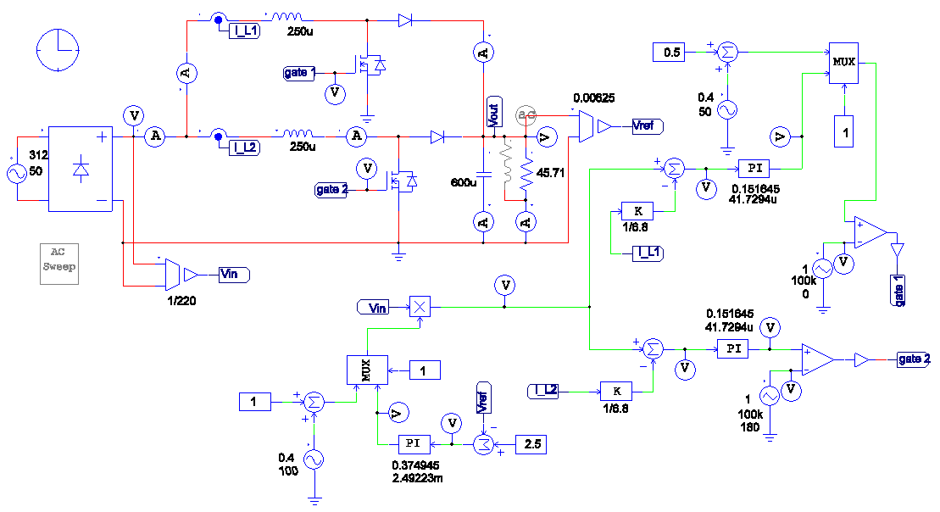
Interleaved PFC Simulation with ripple cancellation

Slide 24
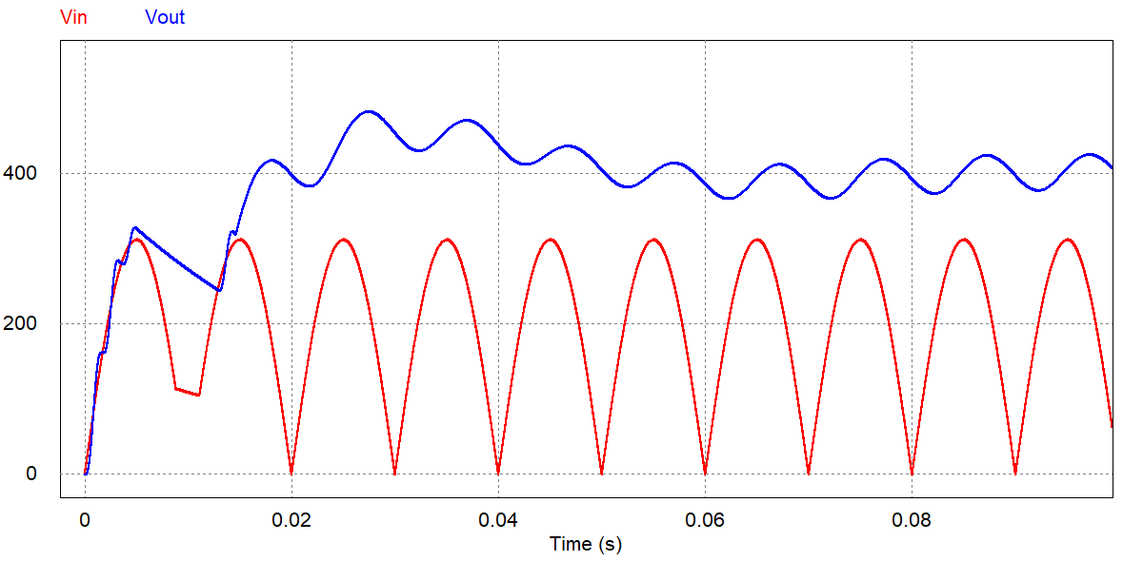
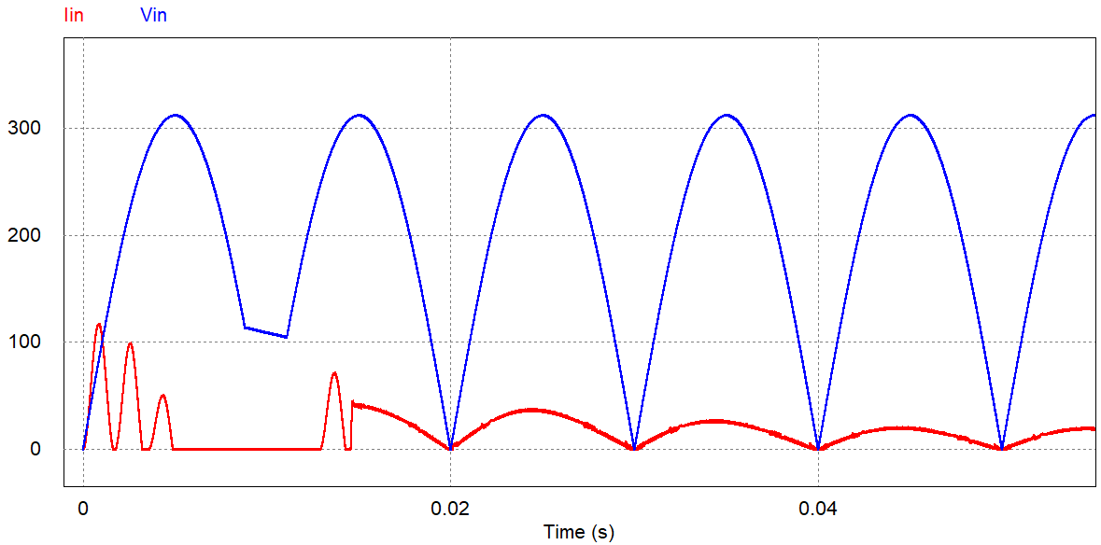
Simulation results
Output Voltage waveform
Input current waveform showing improved power factor

Slide 25
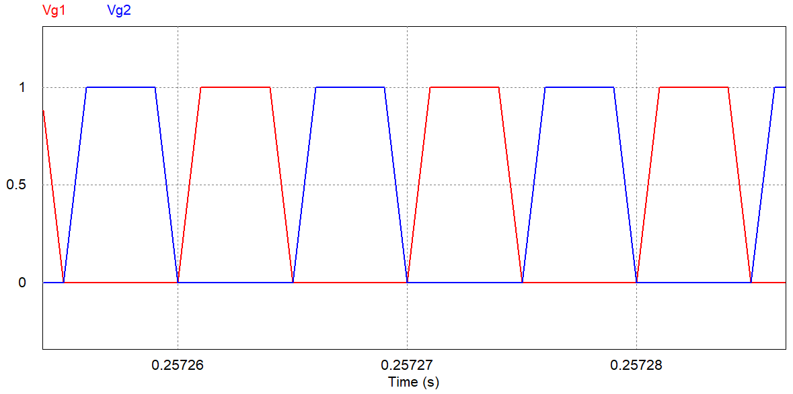
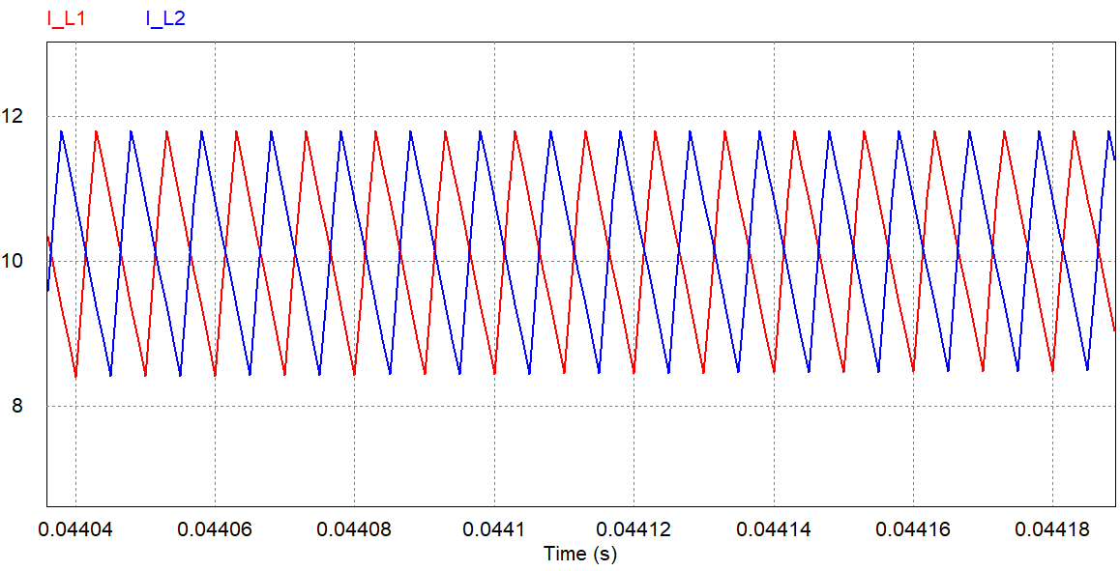
Gate signals and Inductor currents

Slide 26
Design and hardware fabrication of peripheral components
Flyback Converter: As discussed in section 3.4
Microcontroller board: This board houses the processing power of the circuit. It is also used to count time for tripping the relay.
Control and sense board: has the controller IC of the PFC circuit.
Gate driver board
Heat sink

Slide 27
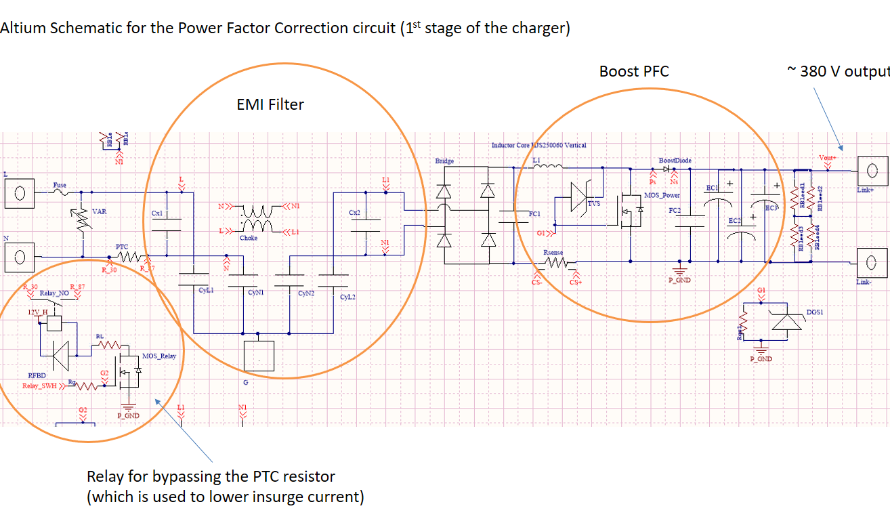

Slide 28
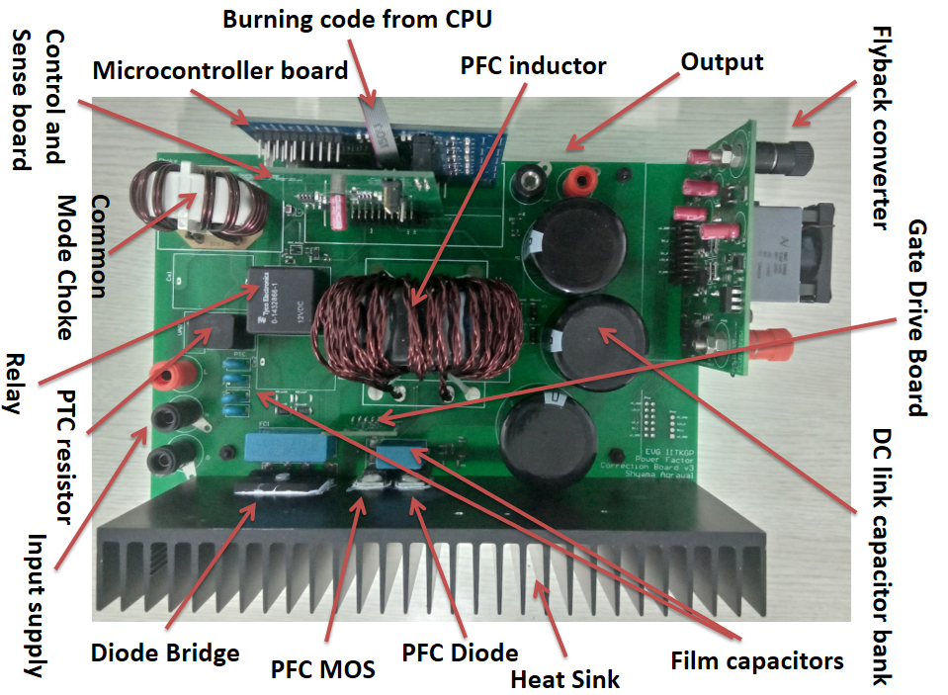
Hardware fabrication

Slide 29
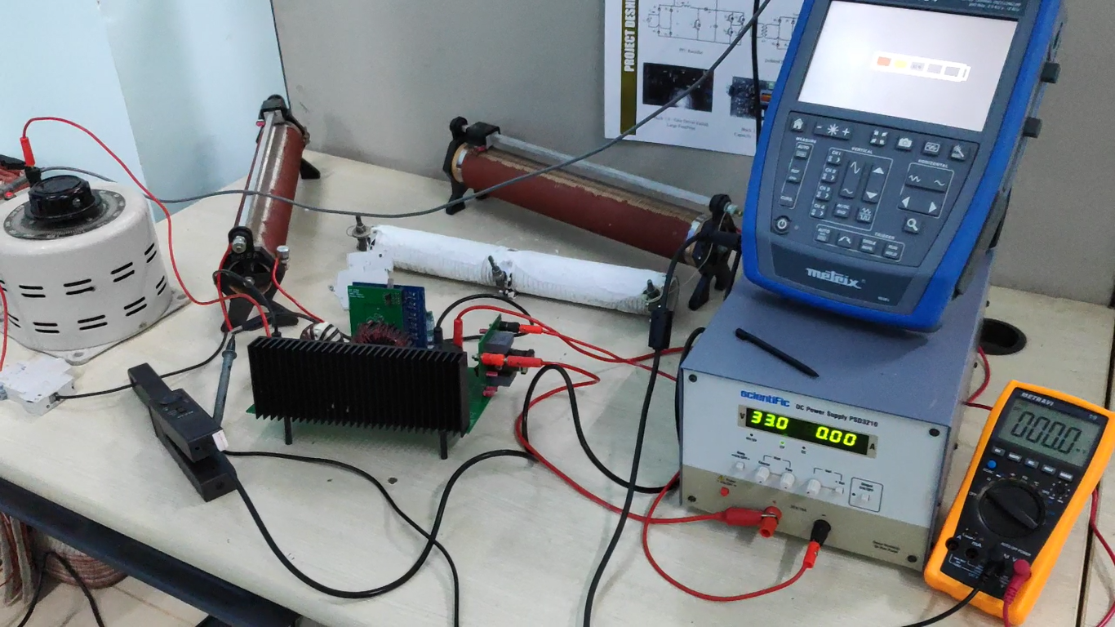
Test Setup (CRR)

Slide 30
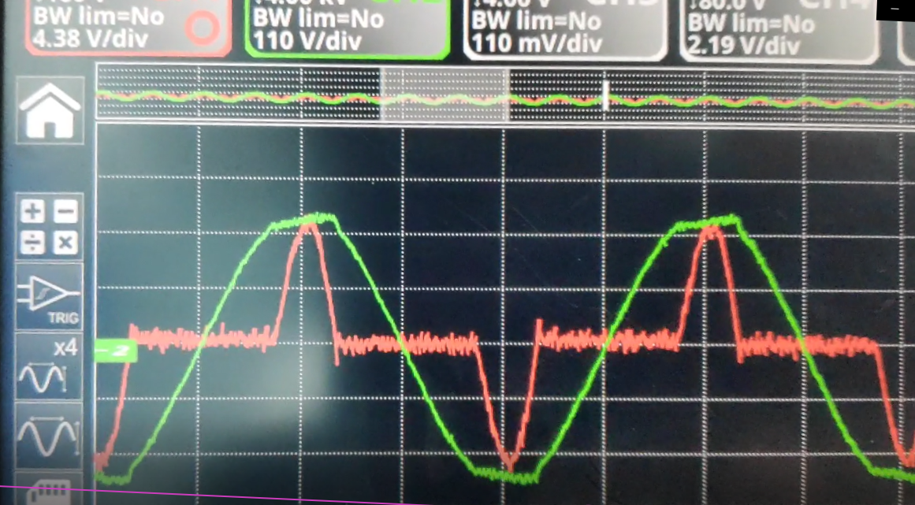
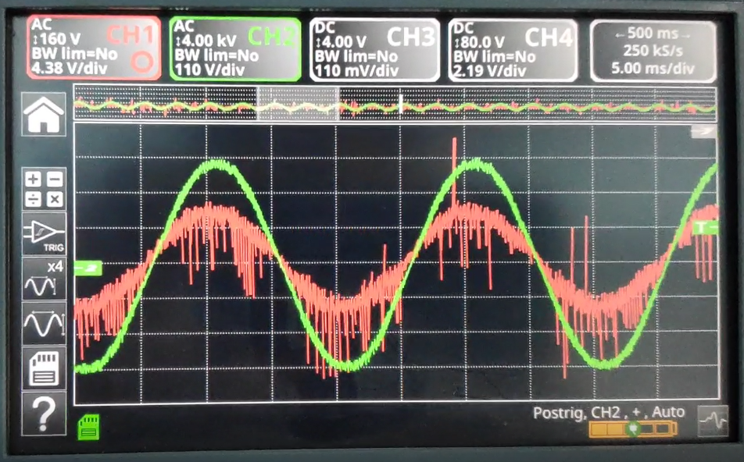
Hardware results
Bad power factor without the PFC
Power factor improved to approximately unity
Possible Noise sources:
EMI, trace inductances

Slide 31
Phase-shifted Full Bridge Converter
Input Voltage Vdc : 400V (max 8A) with V < 5%
Output Voltage Vbattery : 80-85V max during CV charging mode
Output Current Ibattery : 40A max during CC charging mode
Output Power Po : 3kW
Switching frequency fs : 100kHz (switches)
Minimum eciency : 85%
Controller IC used : UCC28951

Slide 32
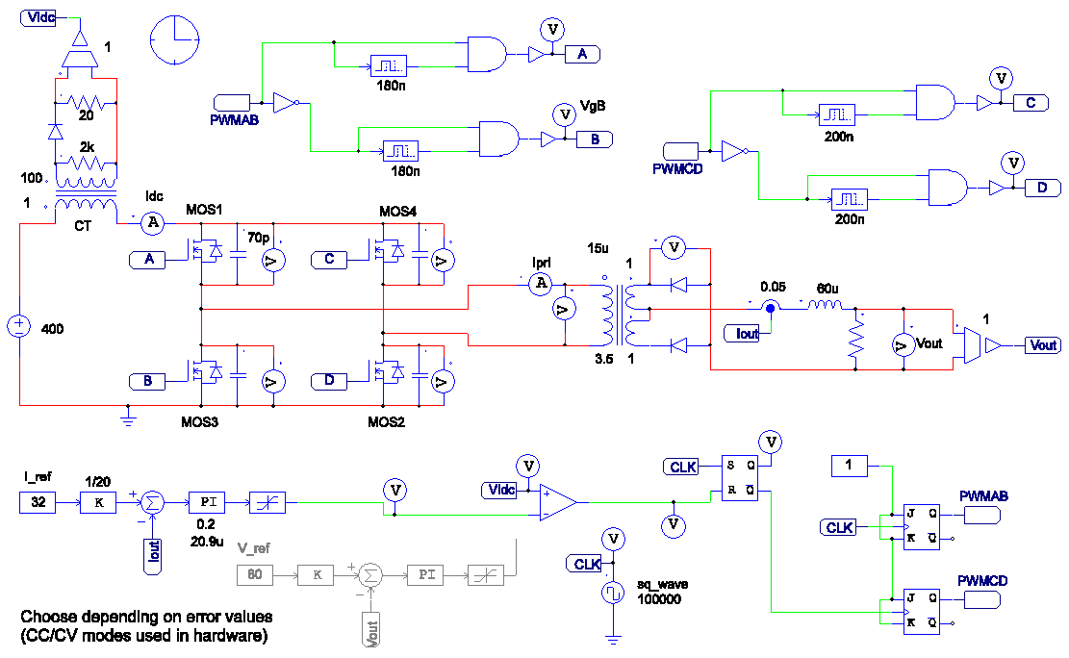
Simulation (Currrent controlled @32A)

Slide 33
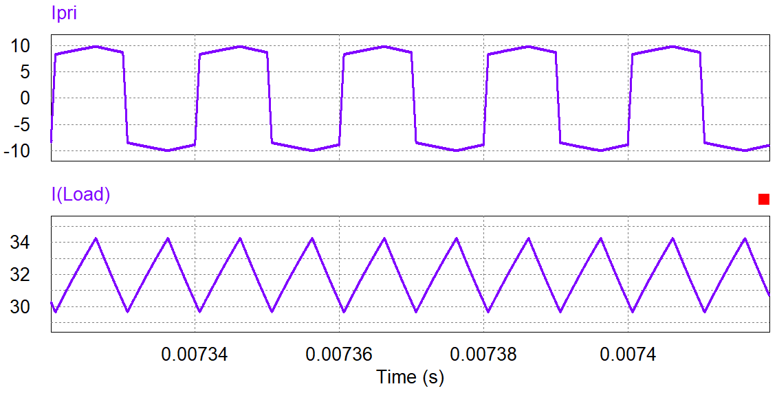
Primary and output currents

Slide 34
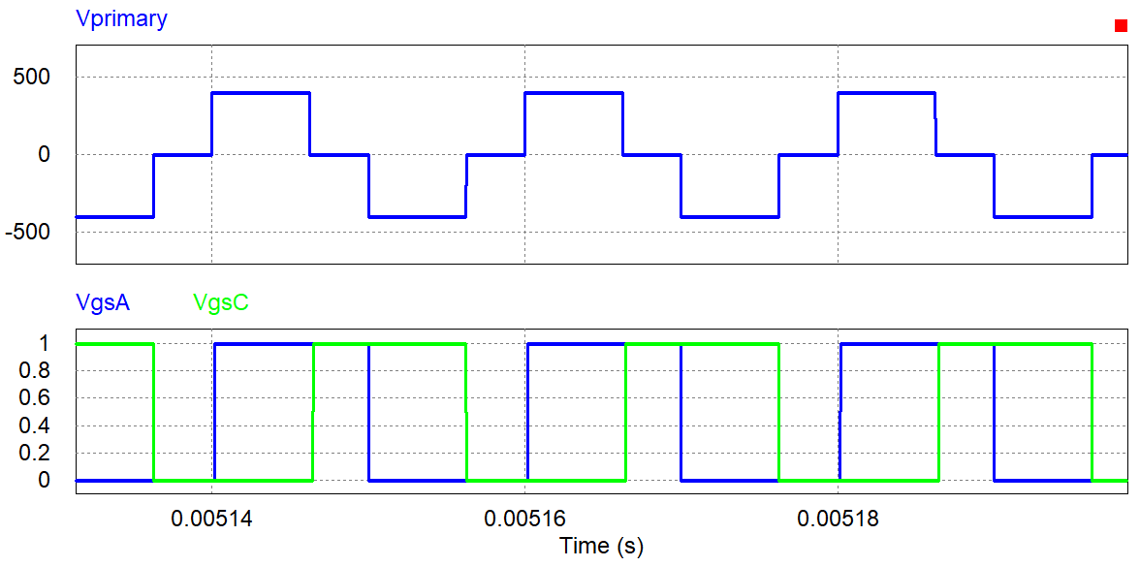
Primary voltage of the PSFB transformer

Slide 35
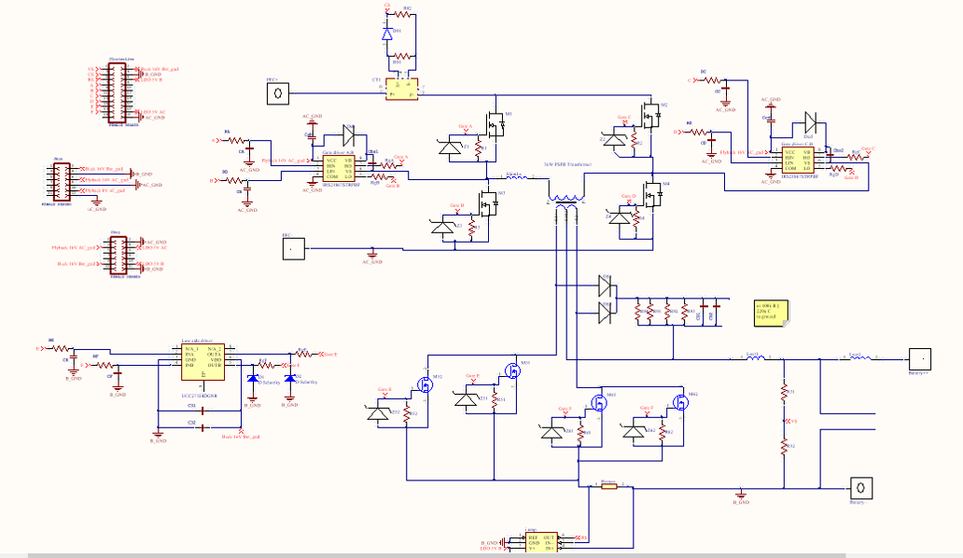
Final Altium schematic

Slide 36
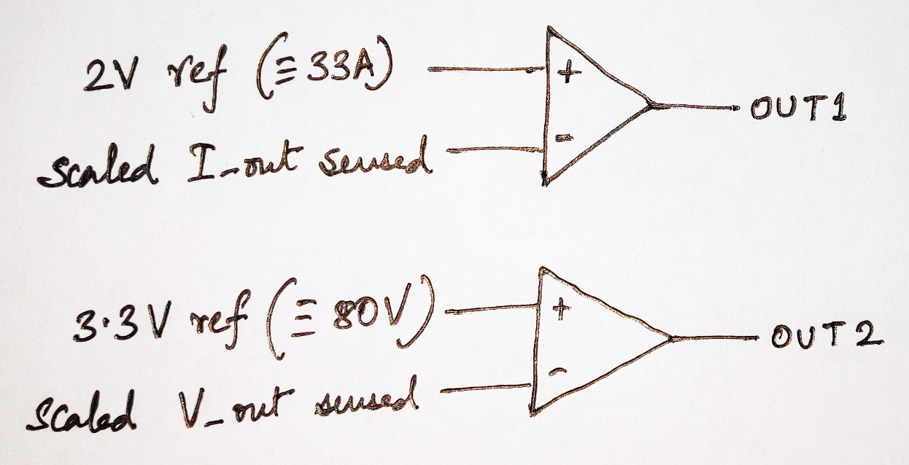
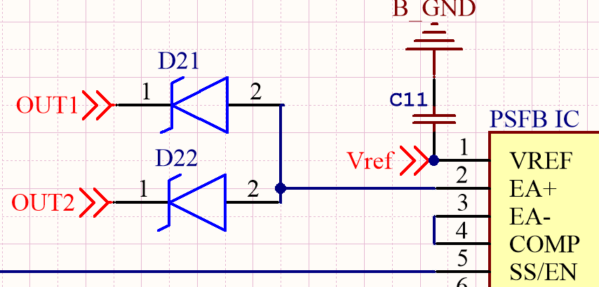
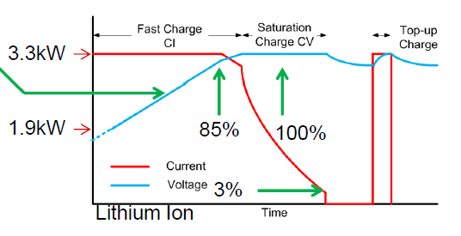
Integration of CC - CV modes of charging
lowest error wins and controls the final output.

Slide 37
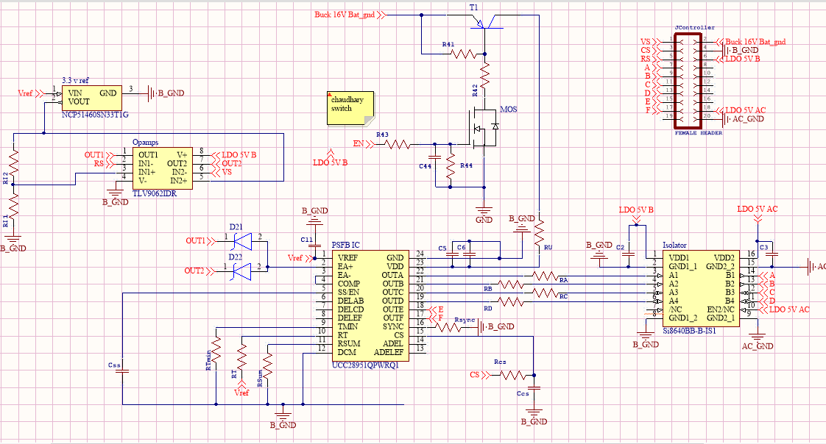
PSFB controller schematic

Slide 38
The PSFB hardware could not be completed, although its PCB layout was made The bulky transformer that is being used can be replaced by planar transformers in future

Slide 39
Conclusion and Future Work
Fabrication and testing of PFC hardware with all peripherals [done]
Simulation of PSFB converter with current control [done]
Although it was not possible to fabricate and test the hardware owing to the unprecedented lockdown, the schematics were prepared. [done]
The PSFB converter needs to be tested along with the PFC
Component sizing can be done more efficiently to reduce the overall size and weight
Heat sink design and fabrication can also be looked into
A central software can also be looked into that would manage BMS and Charger simultaneously and would improve according to the utilization of the user

Slide 40
Thank you

Slide 41
References
[1] Coilcraft q4344-bl datasheet [online] available: https://www.coilcraft.com/pn/q4344-bl.htm. (Accessed on Nov. 12, 2019).
[2] Drawn using circuit drawing tool - vp online [online] available: https://diagrams.visual-paradigm.com/#proj=0&type=circuitdiagram. (accessed on Nov. 10, 2019).
[3] Electric vehicle charging infrastructure / ev battery charging [online] available:https://www.mpoweruk.com/infrastructure.htm. (Accessed on Nov. 6, 2019).
[4] Siemens Matsushita Components. \ferrite core parameters" [online] available :https://www.youspice.com/tag/spice-transformers-simulation/, [accessed : Oct. 26, 2018].
[5] Hugh. Why are electric cars important to society? (benets of electric vehicles) [online]available: https://get-green-now.com/why-are-electric-cars-important/. (accessed on Oct.26, 2019).
[6] Inneon. Buckconverterdesignnote.pdf [online] available: https://www.mouser.de/pdfdocs/buckconverterdesignnote.pdf. (Accessed on Aug. 28, 2019).
[7] Texas Instruments. How to design multi-kw dc/dc converters for electric vehicles(evs) - introduction to battery charging | ti.com video. https://training.ti.com/how-design-multi-kw-dcdc-converters-electric-vehicles-evs-introduction-/battery-charging?context=1128387-1128363. (Accessed on Jan 2020).
[8] Texas Instruments. Ucc28180 programmable frequency, continuous conduction mode (ccm),boost power factor correction (pfc) controller datasheet (rev. d). http://www.ti.com/lit/ds/symlink/ucc28180.pdf?ts=1587905792254. (Accessed on Jan, 2020).

Slide 42
[9] Texas Instruments. Ucc28951-q1 phase-shifted full-bridge controller for wide input-voltage range applications datasheet (rev. a). http://www.ti.com/lit/ds/symlink/ucc28951-q1.pdf?ts=1587936014103. (Accessed on Jan, 2020).
[10] Dragan Maksimovic and Robert W. Erickson. Fundamentals of Power Electronics. Springer,2014.
[11] V. Ramanarayanan. Course material on switched mode power conversion [online] available: http://www.ee.iisc.ac.in/new/people/faculty/vjohn/ref/smpcbook,%20vr.pdf. (Accessed on Nov. 12, 2019).
[12] ROHM. Design example for pwm yback converter [online] available:https://pages.rohm.com/tech download02 en.html. (Accessed on July 20, 2019).51
[13] ON Semi. Ncp1203 - pwm current-mode controller for universal o-linesupplies featuring standby and short circuit protection [online] available:https://www.onsemi.com/pub/collateral/ncp1203-d.pdf. (Accessed on July 20, 2019).
[14] Jinsong Zhu and Annabelle Pratt. Capacitor ripple current in an interleaved pfc converter.Power Electronics, IEEE Transactions on, 24:1506 { 1514, 07 2009.

Slide 43

Acknowledgement
I would like to express my sincere gratitude to my supervisor Prof. Dipankar
Debnath for providing his invaluable guidance and suggestions throughout the
course of the project.
Additionally, I would like to thank Prof. Gautam Poddar and Prof. Tanmoy
Bhattacharyya for teaching me and guiding me in designing Power Electronic
Converters.
I would also like to thank the Electric Vehicle Group, IIT Kharagpur for pro-
viding me with all the facilities required for the project. Also, I would like to
especially thank Mr. Manuj Agrawal and Mr. Shyama Agrawal for helping me
learn PCB designing, NXP FRDM Board programming, soldering and motivat-
ing me towards completion of the project.

